Slide 1
Industrial transformations and workforce planning
Dr Beck Pearse
Fenner School of Environment & Society /
School of Sociology

Slide 2
Acknowledgement of Country
We acknowledge and celebrate the First Peoples on whose traditional land we meet and work, and whose cultures are amongst the oldest continuing cultures in human history

Slide 3
Agenda
01 | Intro. Energy as a labour issue | 25 mins
02 | Best practice policy | 25 mins
 | BREAK | 10 mins
03 | Lessons so far | 25 mins
04 | Reflections from SE Asia | 25 mins

Slide 4
1. Energy as a labour issue

Slide 5
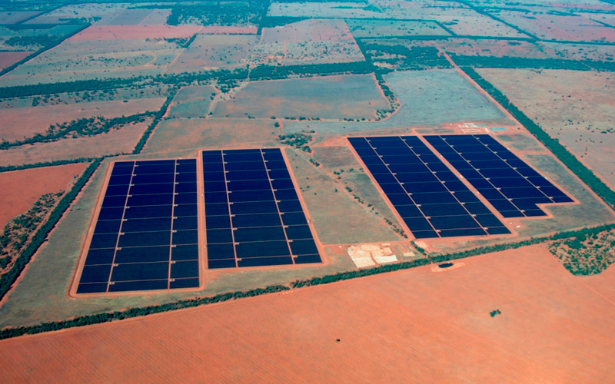
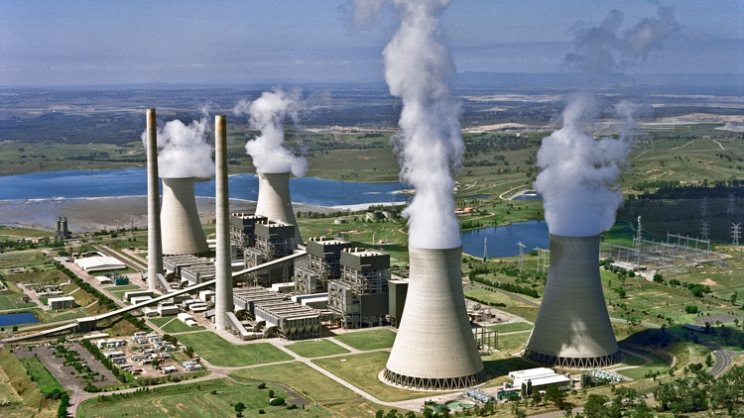
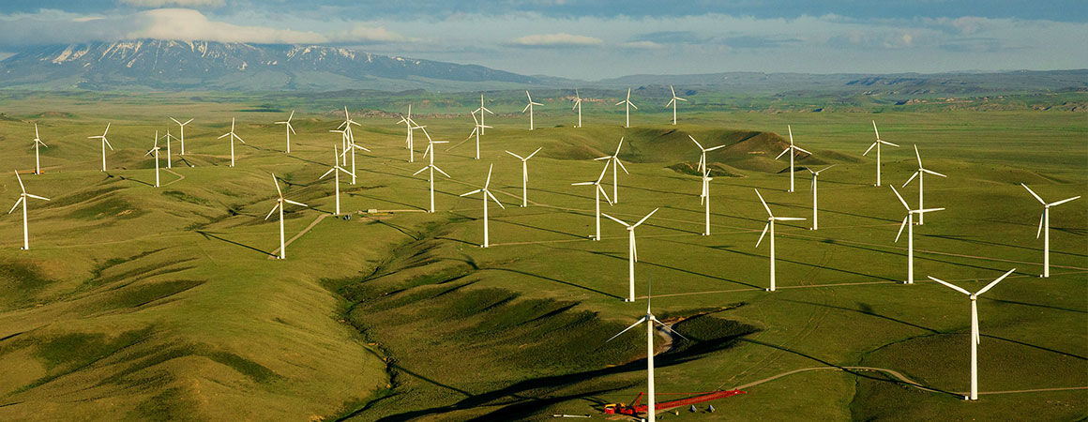

Slide 6
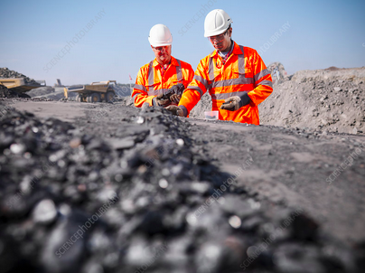
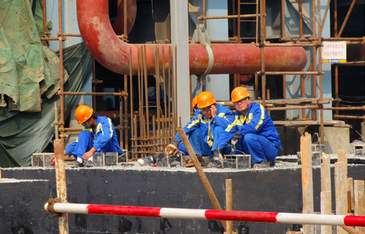
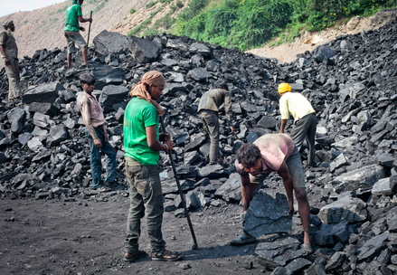
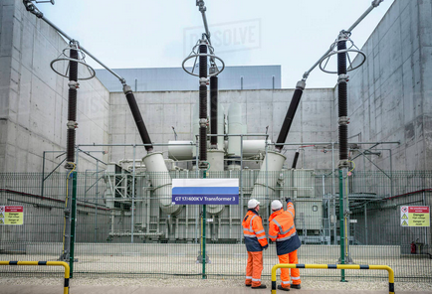

Slide 7
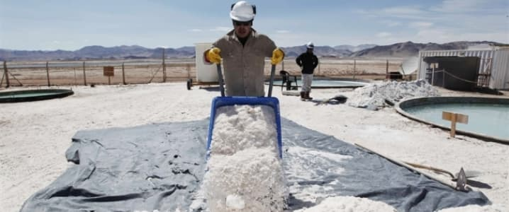
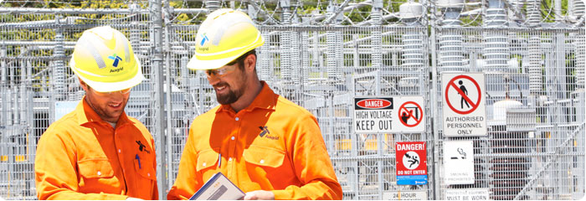
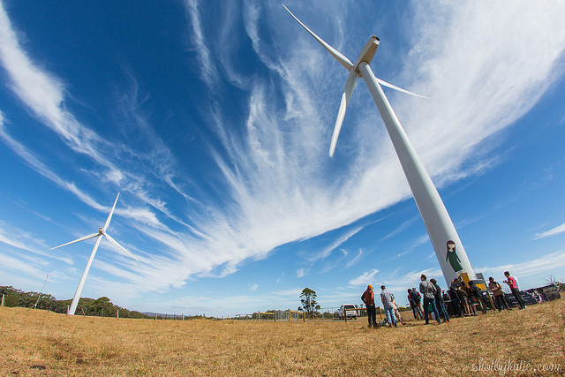

Slide 8
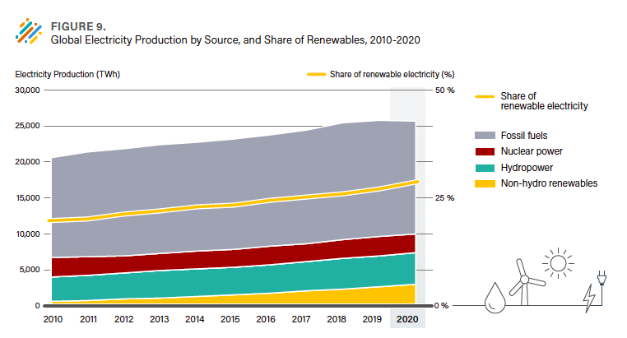
Energy transition as a fuel switch

Slide 9
Capacity of existing and proposed coal, large-scale wind and solar projects in NSW Australia.
Energy transition as a fuel switch

Slide 10
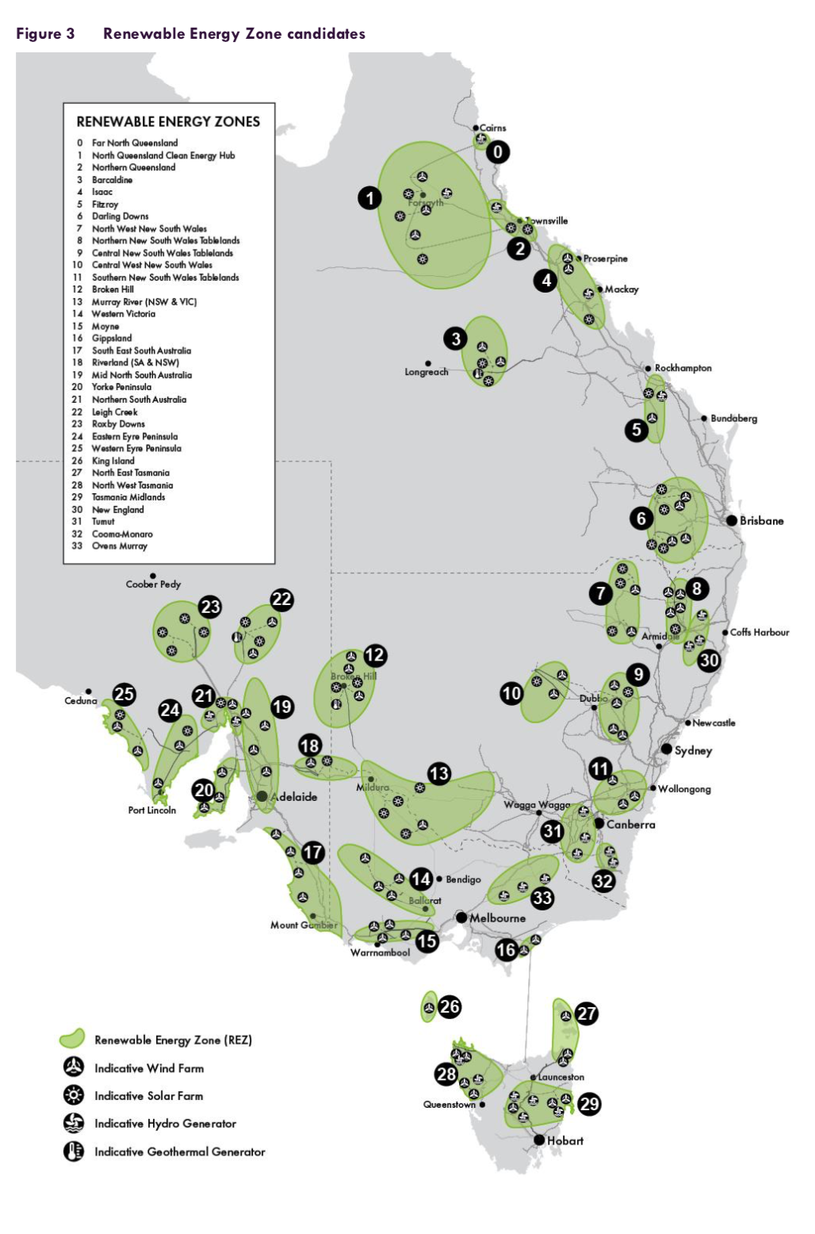
Energy transition as an infrastructure project

Slide 11
Large scale generation capacity by NSW region (MW): operational, under construction and planned
Energy transition as a spatial shift

Slide 12
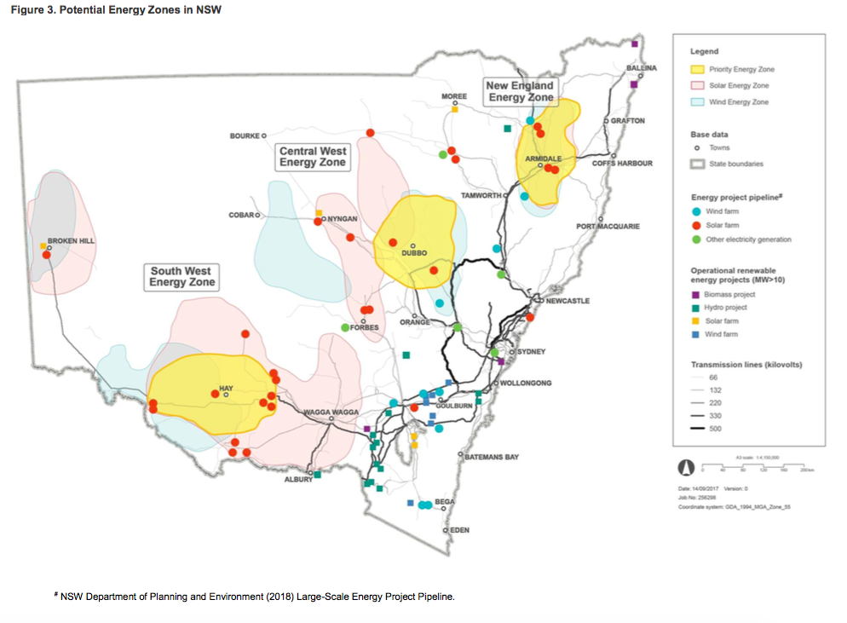
Priority Energy Zones (NSW Govt 2018)

Slide 13
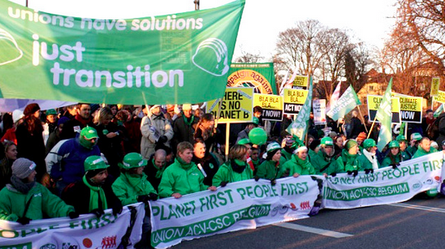

Slide 14
Just transition: What is it? Who needs it?

Slide 17
Just transition in a labour perspective How does work (paid and unpaid) change during energy transitions?

Slide 18
Labour as a production cost (commodity) Labour as divided (segmented workforces, households) Labour as a subject of regulation (institution) Labour as a protagonist (social agent)
Labour perspectives

Slide 19
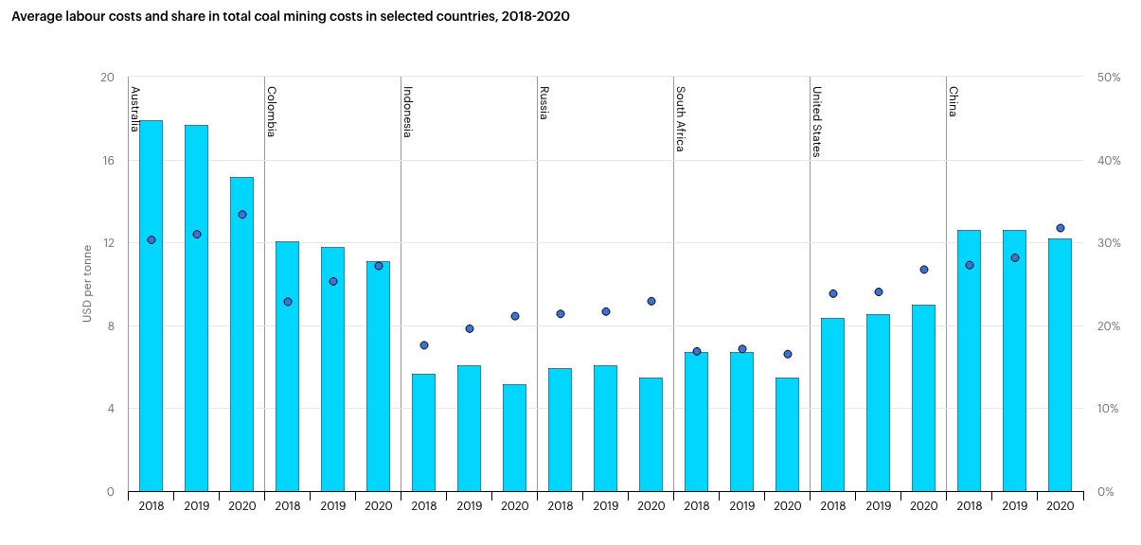
Labour as commodity
Notes:
https://www.iea.org/reports/coal-2020/prices-and-costs

Slide 20
Labour institutions

Slide 21
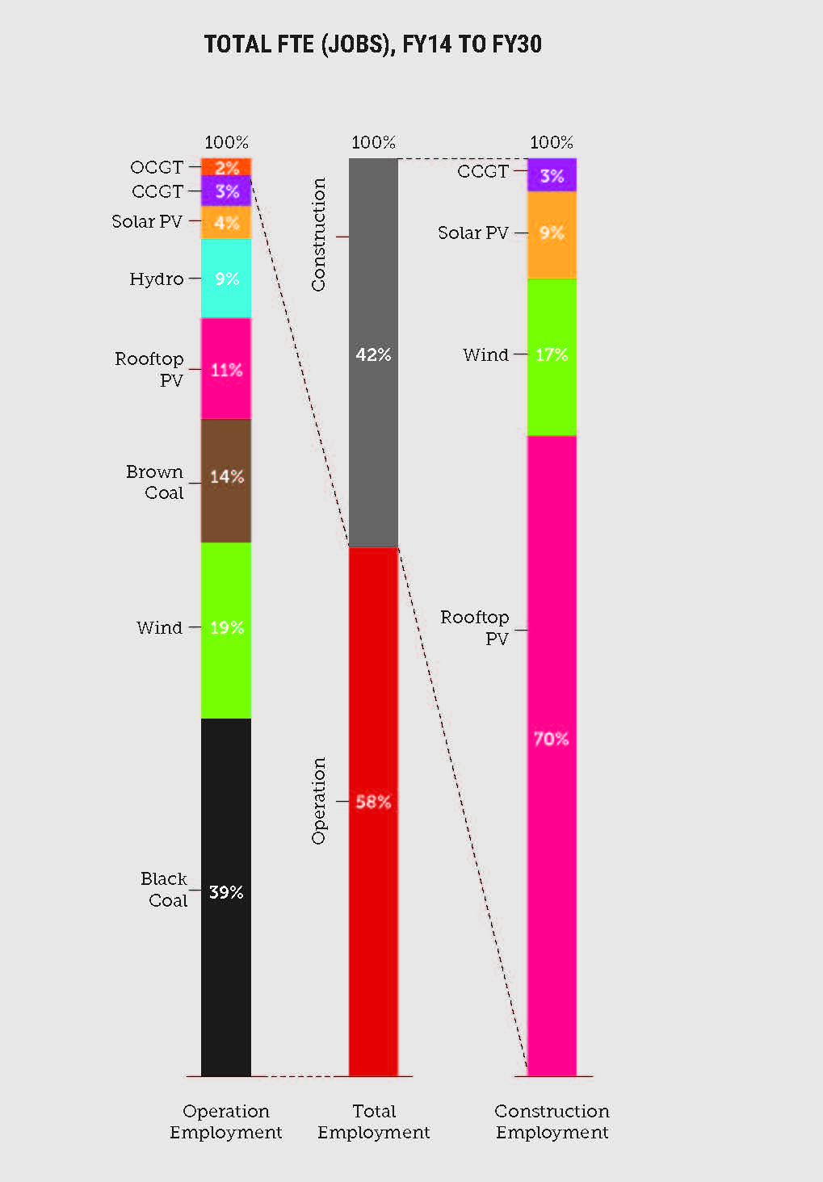
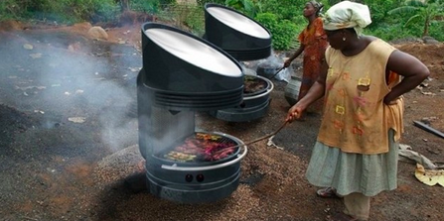
Segmented work

Slide 22
Labour as an interest group
Notes:
https://www.etunational.asn.au/learning_the_lessons_of_good_and_bad_transitions

Slide 23
Which of these ways of seeing labour make most sense to you? If different stakeholders see labour differently, how can those different perspectives be navigated?
Discussion

Slide 24
Labour in multiple dimensions
Labour as a peculiar commodity
Labour markets present dilemmas of social regulation
Incorporating labour
Allocating labour
Controlling labour
Reproducing labour

Slide 25
Current global labour situation (ILO 2022)
Unemployment
2022: 207 million
2019: 186 million
Pandemic recovery inequalities
low- and middle-income countries have remained significantly below those observed in richer economies
efficacy of policy instruments impaired by large informal economies
growing contingent employment, impairing quality of work conditions
disproportionate impact on women’s LF participation

Slide 26
Labour in Africa (AFDB 2021)
Pre-pandemic:
widespread informality, working poverty, underemployment and the prevalence of low-productivity work.
COVID impact:
1.9 per cent in 2020,
30.4 million Africans fell into extreme poverty in 2020; another 38.7 million in 2021.

Slide 27
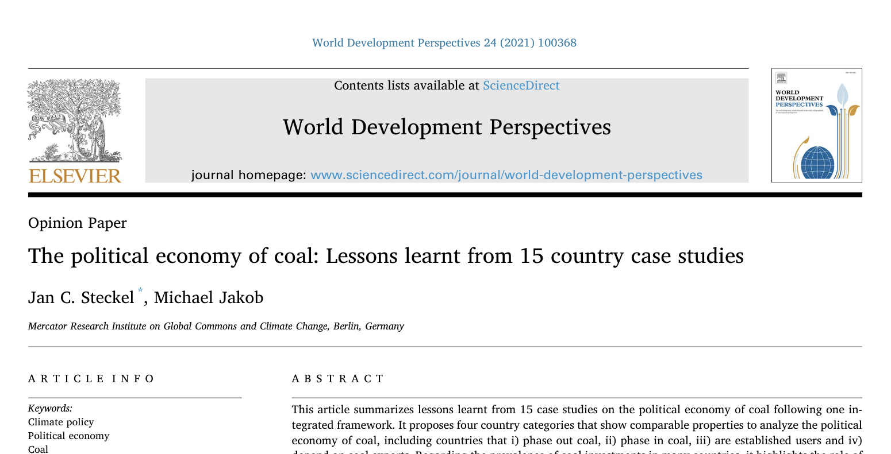
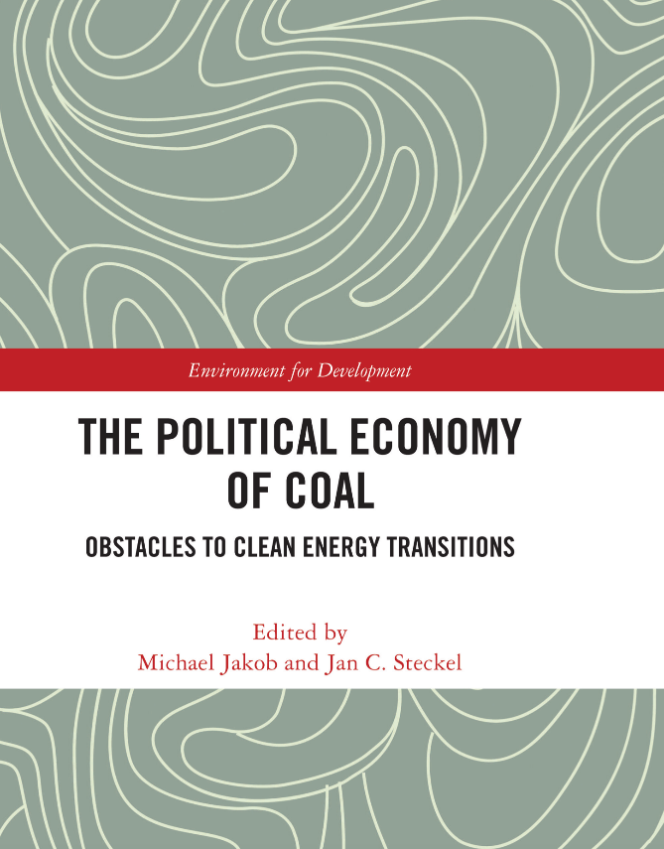
Fossil fuel workforce transitions: the issues
‘Surprise’ mass redundancies
Older workforce with informal skills
No comparable appropriate employment
Psychological and social effects
Losses spread to regional economy
Vested interests in local job losses. And lobbying.
Social expectations regarding regional development, royalties.

Slide 28
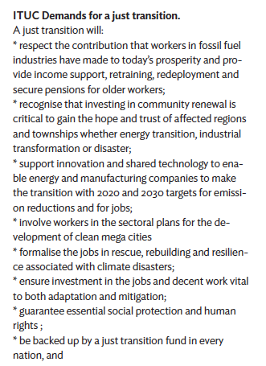

Slide 29
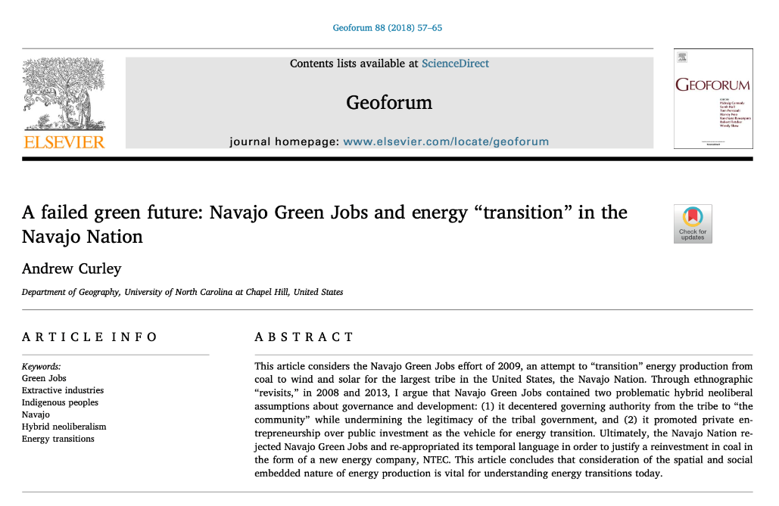
RE workforce transitions: the issues
Mining: precarious labour
Manufacturing: hazardous chemical exposure, poor factory conditions
Installation: migrant, temporary labour
Utilities: public → private sector
Prosumers: households navigating market regulation

Slide 30
Cameron, Lachlan & Bob Van Der Zwaan (2015), 'Employment factors for wind and solar energy technologies: A literature review', Renewable and Sustainable Energy Reviews, 45: 160-172.

Slide 31
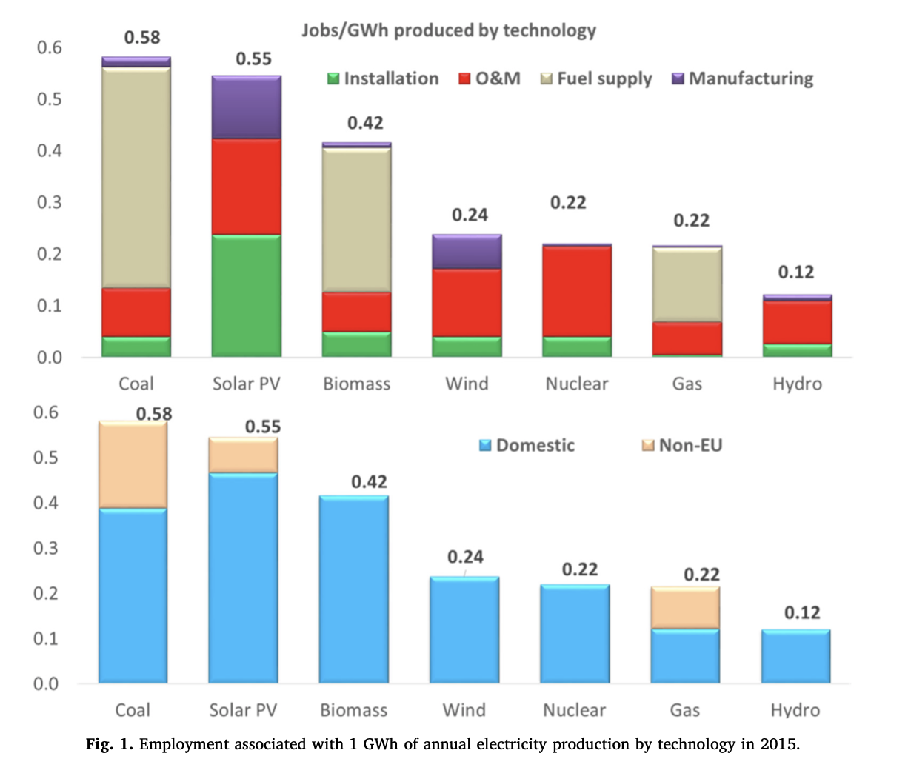
Fragkos, Panagiotis & Leonidas Paroussos (2018), 'Employment creation in EU related to renewables expansion', Applied Energy, 230: 935-945.

Slide 32
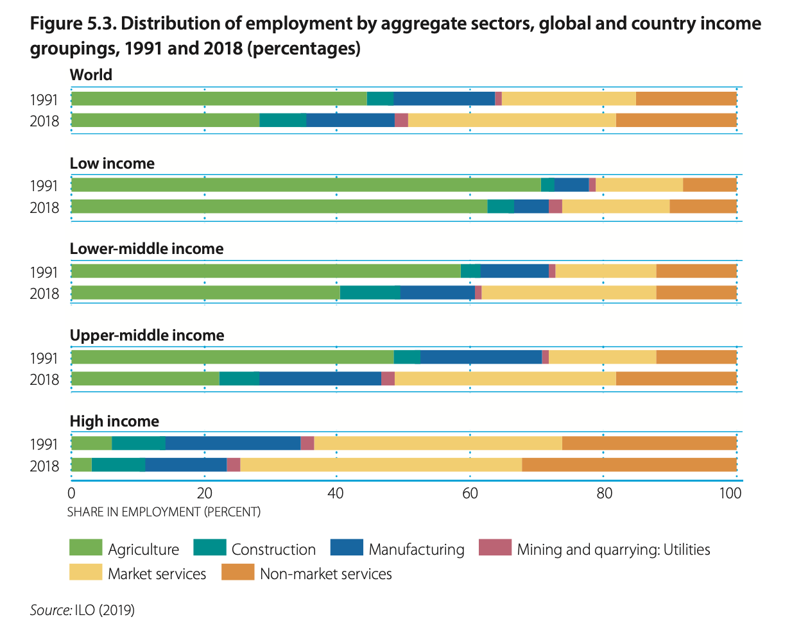

Slide 33
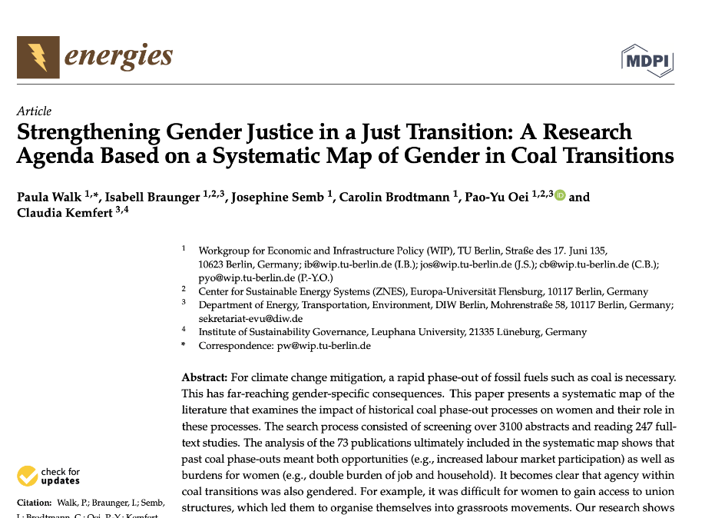
Gendered energy transitions: the issues
Gendered labour market effects, due to occupational / industrial segregation
Increased LF participation → increased self-esteem, confidence, gaining some financial independence
--
Limited access to skills, education
Unequal distribution of household and care responsibilities
Women’s low level of control over household income and resources

Slide 34
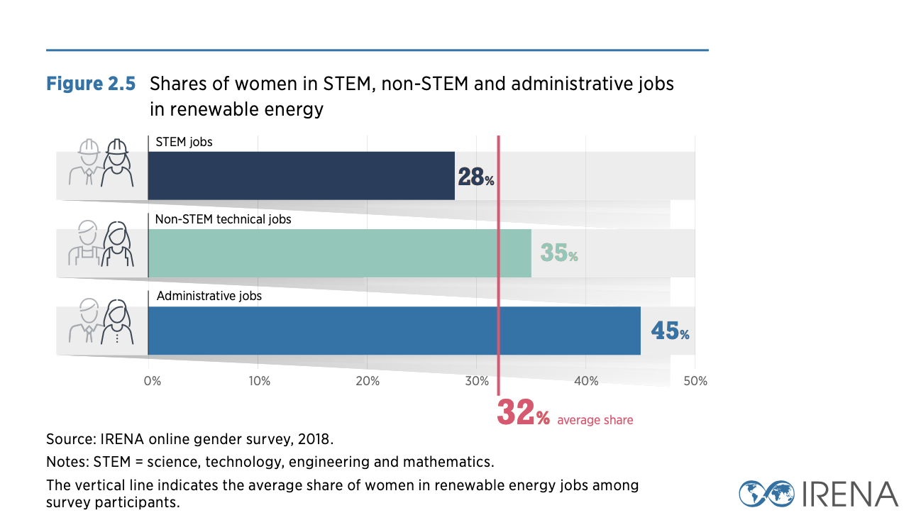

Slide 35
‘The real rural energy crisis is rural women's time, with women working longer work days than men in providing human energy for survival activities such as fuel and water carrying, cooking, food processing, transport, agriculture and small enterprises, non-monetized work which is largely invisible in national energy accounts and labour force statistics’
RE work in gender perspective
Oparaocha, Sheila & Soma Dutta (2011), 'Gender and energy for sustainable development', Current Opinion in Environmental Sustainability, 3(4): 265-271.
Notes:
ENERGIA International Network on Gender and Sustainable Energy

Slide 36
Energy transition and labour
Multiple dimensions:
Labour markets
Regional economies
Total social division of labour (gender)

Slide 37
2. Best practice energy transition policy

Slide 39
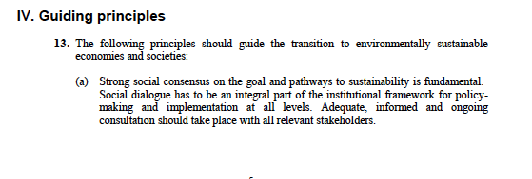
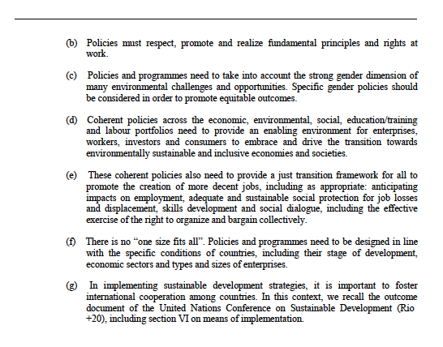

Slide 40
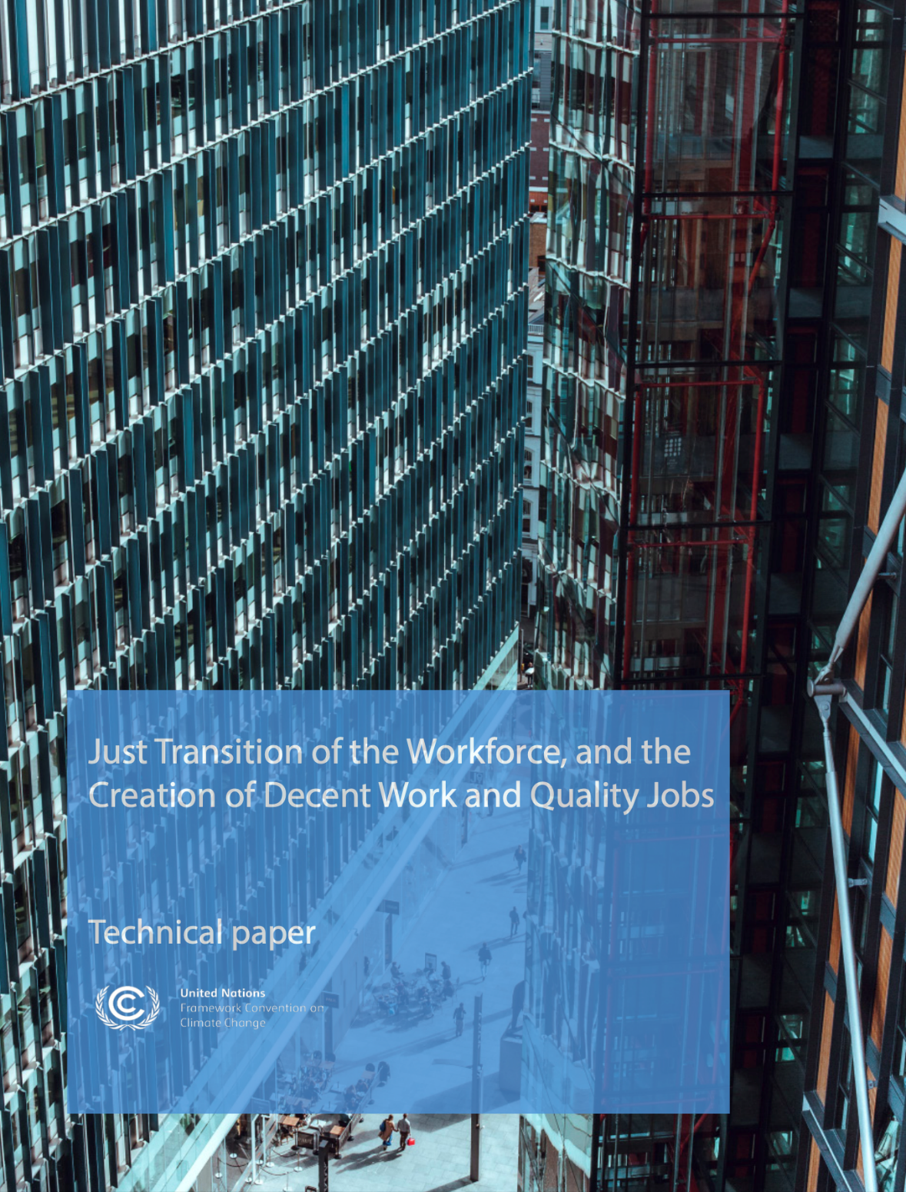
Broad industrial strategies
just transition of the workforce;
creation of decent work and quality jobs;
economic diversification and transformation;
gender equality.

Slide 41
1. Closing fossil fuel facilities
Long-term planning
- Consultation
- Independent authority
- Public funds for transition arrangements
Workers
- Skill development, retraining
- Industrial and environmental policies to attract investment to impacted regions
Communities and regional economies
- Economic development opportunities, alternatives

Slide 42
Pre-transition
During transition
Establish a timeline for decarbonization using social dialogue
Create plans for new low-carbon industries
Compensation to workers, retraining and re-employment opportunities
Financial incentives for low carbon industries and support for existing industries to transition to low-carbon alternatives
Investment in community infrastructure

Slide 43
2. Active labour market policies for decent jobs
Productive employment and decent work are key elements to achieving just energy transition
Policies promoting greener products, services and infrastructures → higher demand for labour in green and emerging sectors and activities (solar panel technicians, construction workers, etc.).
Employment services for improving the match between labour demand and supply in new energy sectors
Retraining workers and upgrading skills.

Slide 44
2. Active labour market policies cont.d
Vocational and on-the-job training programmes improve employability of the unemployed + retrenched workers
Public employment programmes can help tackle the problem of unemployment and underemployment during transitions while addressing climate adaptation issues
Subsidies can also create green jobs in loca- tions with high levels of unemployment or low levels of economic activity.

Slide 45
Decent work for sustainable development

Slide 46
3. Economic diversification
Rural RE is not labour-intensive
Focus on rural economies, where agricultural growth can → non-farm work
Strengthening small farms, because they employ the vast majority of the agricultural labour force
Developing food product markets, and reducing risk for producers seeking access to international trade
Territorial policies aiming at strengthening rural-urban linkages through the promotion and development of the service functions of small cities and country towns (not just big cities

Slide 47
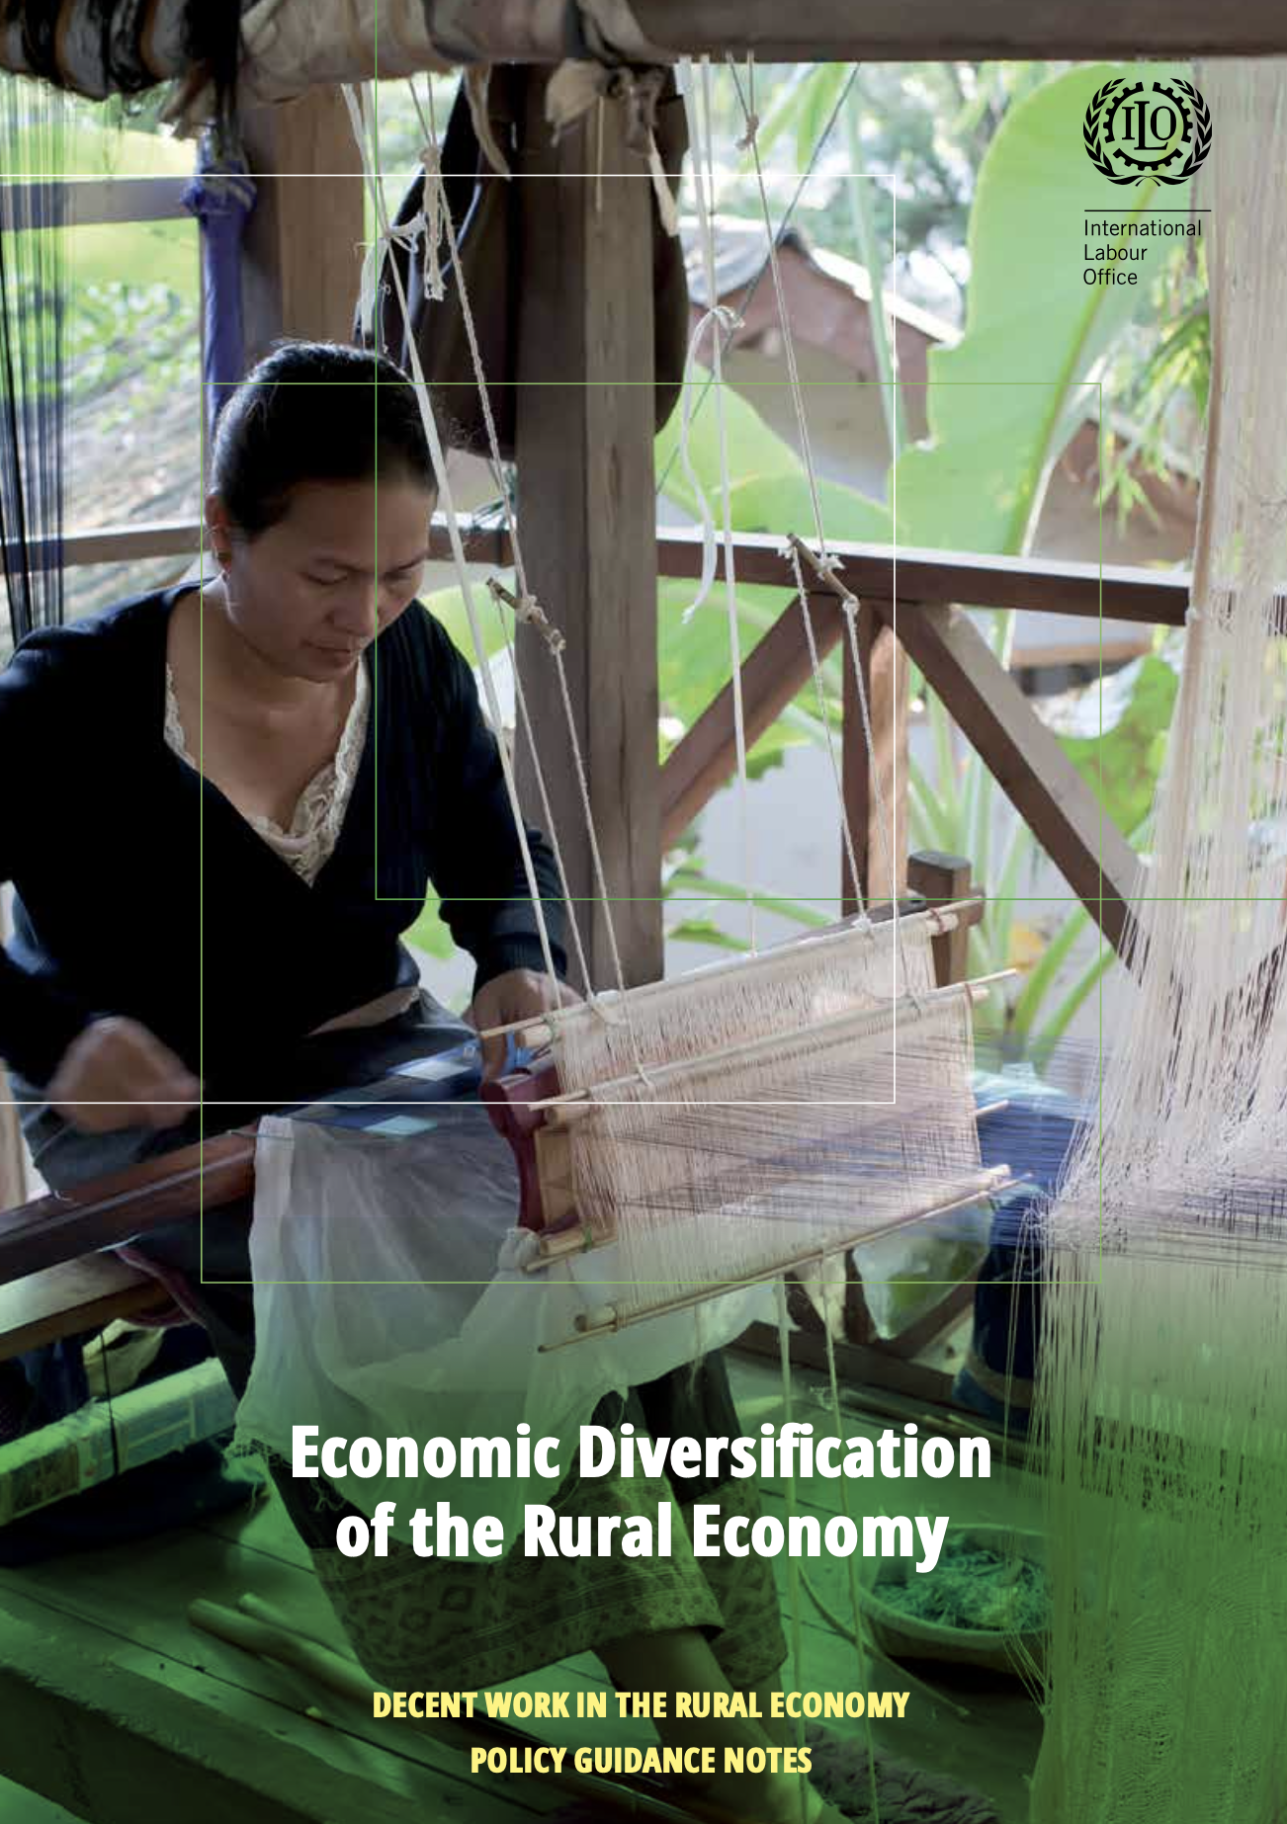
Diversification agendas

Slide 48
4. Gender equality
Build capacity of women to work in the energy sector, and of both women and men to engage with gender issues in energy systems.
Affirmative action initiatives to encourage recruitment of women into RE e.g. gender targets
Retention policies (e.g. childcare), mentorship and training
Flexible work and relaxed mobility requirements
Gender mainstreaming, workplace cultural interventions

Slide 49
4. Gender equality cont.d
Invest in energy infrastructure technologies and end-uses that directly meet poor women's energy demands and reduce their drudgery. Promote sustainable livelihoods through modern energy services that permit poor women to increase their productivity and income
Increase poor women's choices of cooking fuel.
Promote energy access as a critical intervention for other development sectors Include and document gender analysis at each step of policy, programme and project planning, implementation, monitoring and evaluation.

Slide 50
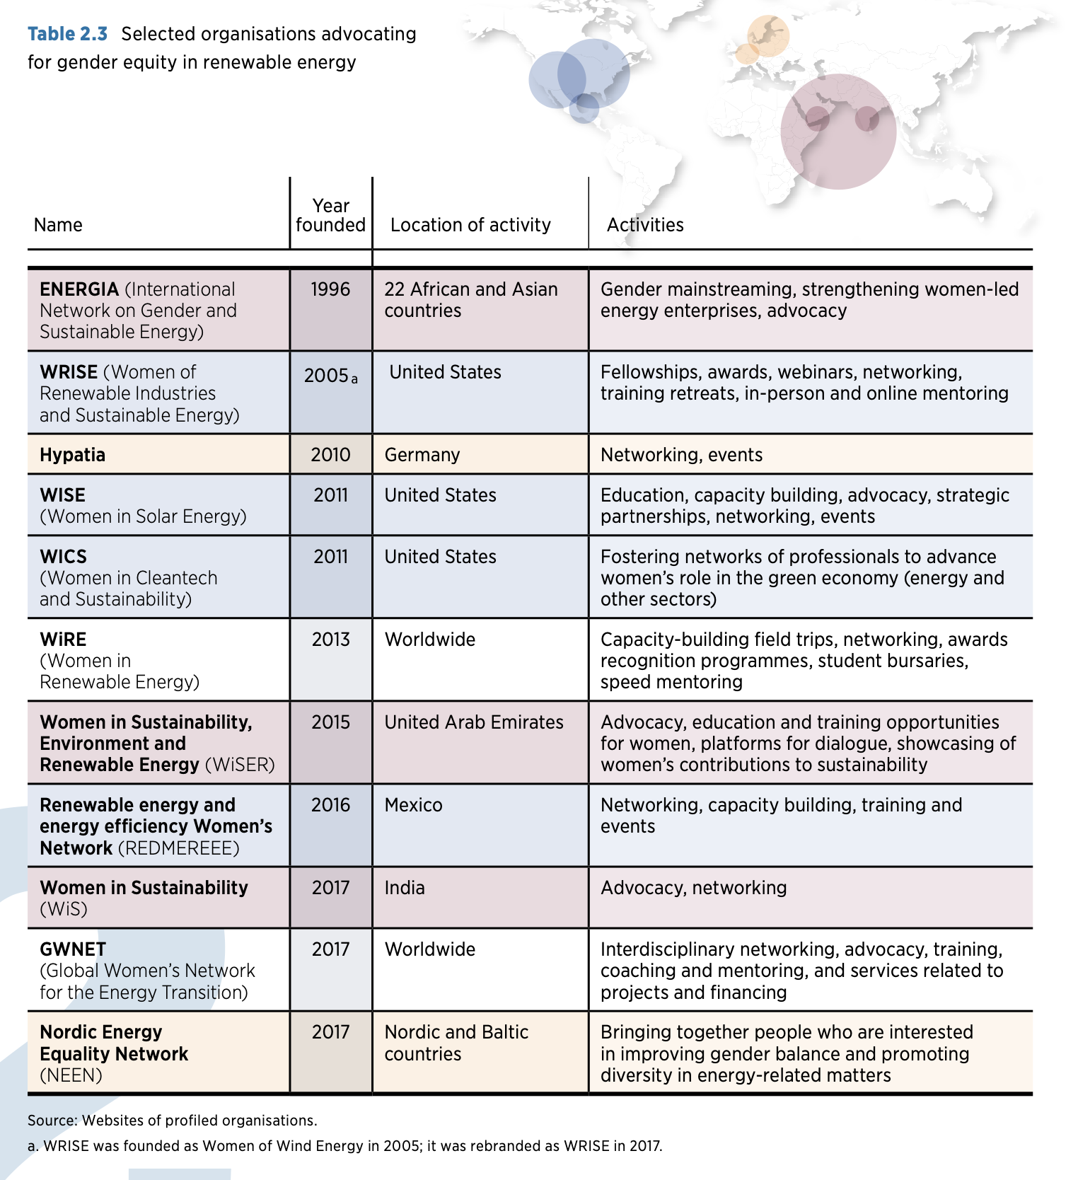
Gender mainstreaming initiatives

Slide 51
Institutional conditions for best practice
Social dialogue: Long-term planning and cooperation between stakeholders with potentially conflicting needs and goals (especially business, unions, government and communities).
Broad labour strategies: beyond energy, looking to create diverse economies with greater equality among workers
Notes:
1. Industrial change, and therefore work, is at the centre of the social transition 2. Renewable energy (RE) is a rural spatial shift 3. Fossil fuel workforces are concerned about livelihoods and future 4. Policies for decent green work should be broad.

Slide 52
3. Lessons so far

Slide 53
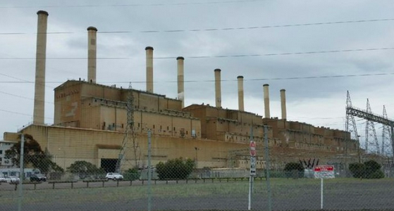
Hazelwood power station, Victoria Closure 2017
Wiseman, John, Stephanie Campbell & Fergus Green (2017), Prospects for a “just transition” away from coal-fired power generation in Australia: Learning from the closure of the Hazelwood Power Station, Canberra: Crawford School, ANU

Slide 54
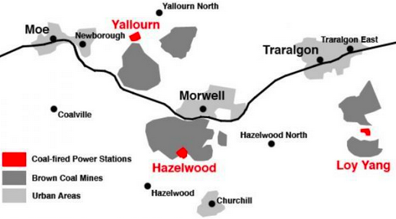

Slide 55
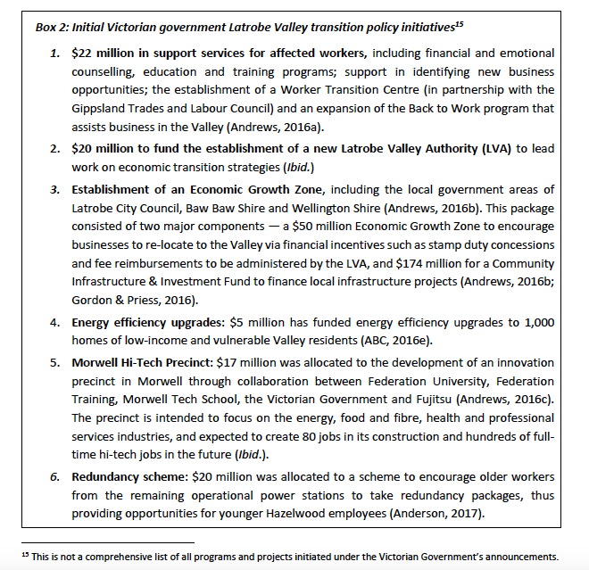

Slide 56
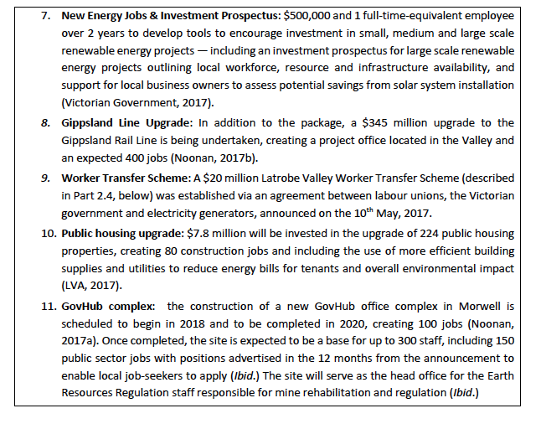

Slide 57
Regional Communities and Renewable Energy: A Socio-economic Study in New England & Central West NSW
Funding from University of Sydney Research Portfolio
Research team:
Professor Linda Connor (Anthropology, University of Sydney)
Dr Rebecca Pearse (Political Economy, University of Sydney, now ANU)
Mr Dan Cass (Strategy, The Australia Institute)
Riikka Heikkinen (PhD candidate, UTS)
Notes:
Introduce the team, funded by Sydney uni and supported by TAI. About 8 months, February to September 2019.

Slide 58
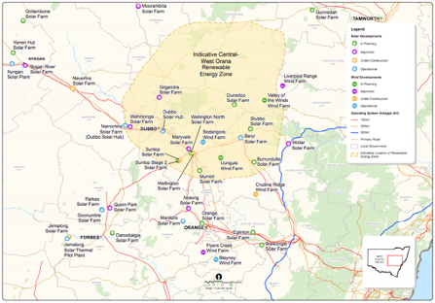
NSW Central West REZ
Energy transition regional planning

Slide 59
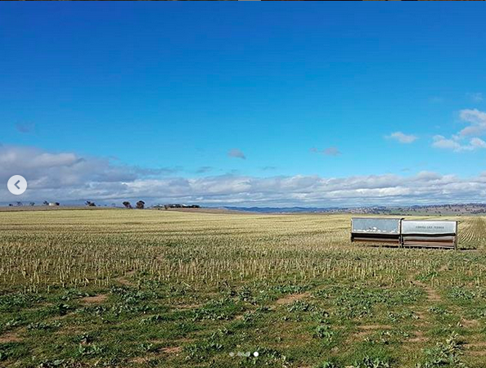
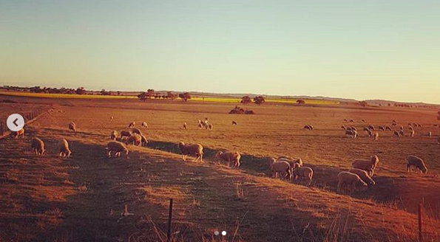
Renewable energy in Central West NSW
Notes:
Scale and pace – it had the first large solar farm install from AGL in Nyngan. Couple more sig solar farms in and around Parkes,

Slide 60
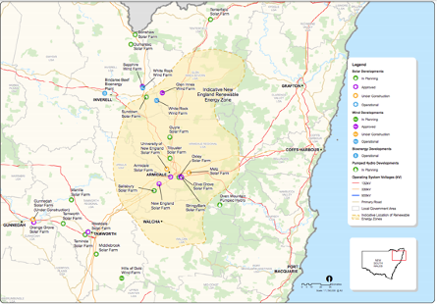
NSW New England REZ
Energy transition regional planning

Slide 61
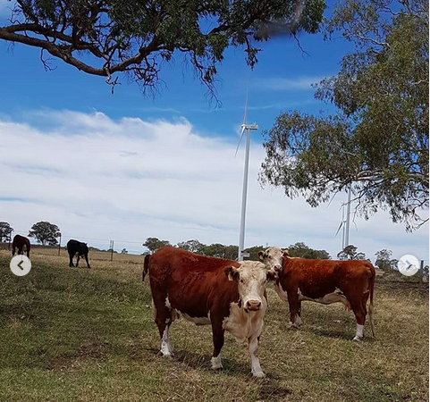
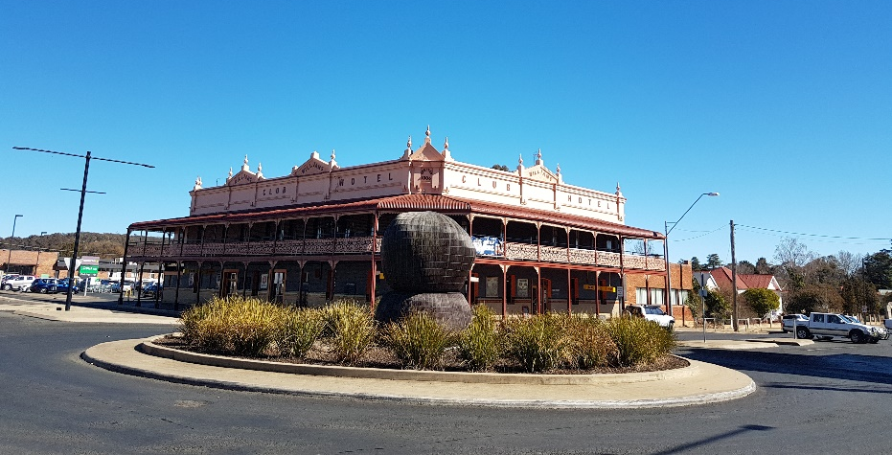
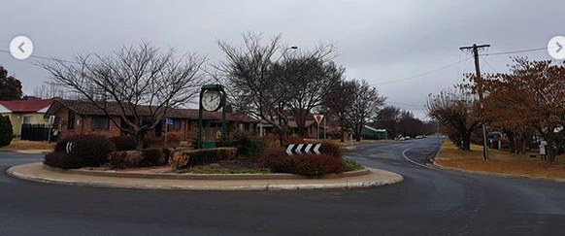
Renewable energy in New England
Notes:
Scale and pace – two established large scale wind farms between Inverell and Glen Inness. Both have solar additions either in place or approved. One more significant turbine extension for Whiterock.
South of Armidale, NE of Uralla. One major solar farm project proposal for outside Uralla on Salisbury Plains. A sig solar farm proposal by Neoen cancelled amided community opposition in Samaurez nearby. Another contested wind and solar project near Walcha. A smaller solar farm developed by Chinese firm E of Armidale.
So – significant growth on the table.
Flow of benefits:
Sigifnicant tensions over land use change. Particularly between neighbours and hosts of turbines. Our participants reported relatively less anxiety about the cahnges now infrastructure is there. But the process of development remains an issue for them. E.g. consutlation, agreements they were asked to sign, the limited neighbour payments, the light pollution, ongoing traffic impact for hosts as well. Heritage and amentiy issues.
Residents we spoke to through Glenrac were open to RE. Observed that the flow of benefits was relatively limited. Doesn’t contribute to the productive base of the regional economy. But that’s not to say the community grant funding isn’t appreciated etc.
Local government officials and representatives on the whole have been concerned with the tradition changes related to roads, rates and rubbish.

Slide 62
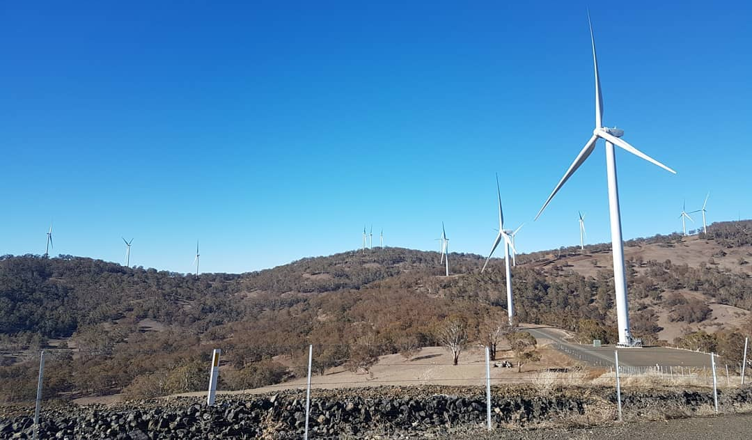
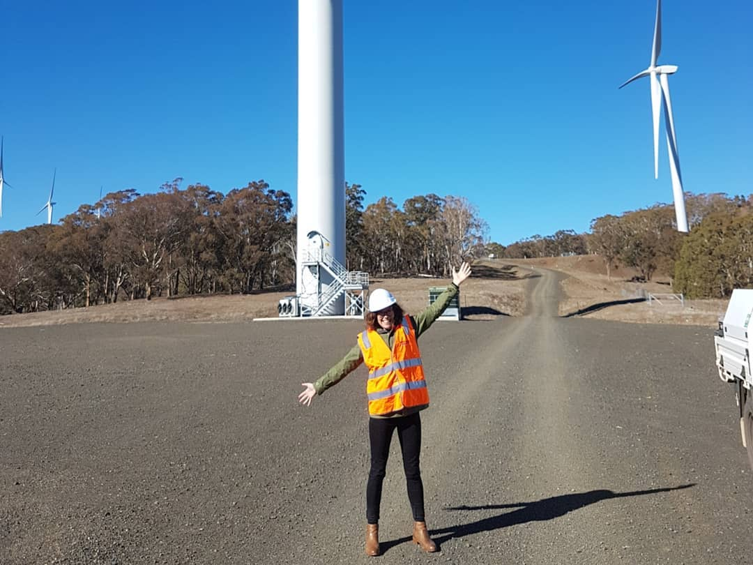
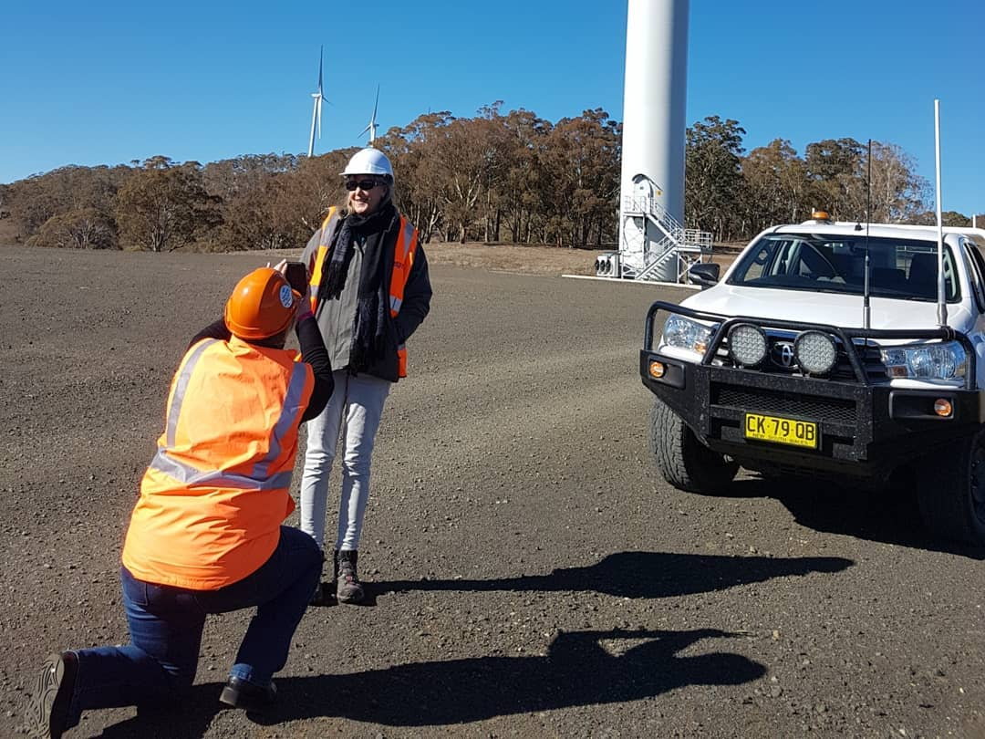
Renewable energy in New England

Slide 63
The RE work boom T]here are so many incredibly large deliveries passing through town that the state highway patrol has booked four rooms at the Central Motel for the duration of construction, according to hotel manager Wanda Kelly. Next door owner of the Great Central Hotel Tony Hills says the new wave of men in hi-vis has delivered a 10 per cent lift to his business (Brown 2017) [renewable energy companies] are very keen to keep a good name in the community. The workers would fill their vehicles in town before they left, or they’d get local caterers, or they’d sponsor local activities, that sort of thing. (Town worker) Limits on capacity We encouraged local businesses to go out and gear up to for the new work. Some did, some just didn’t have the capacity to work in that larger business field. The local crane hire firm, they’ve bought additional plant and got a lot of work out of the project. They’ve continued to expand on the back of it and picked up other larger projects. ` (Council officer)
Work in REZ
Notes:
[renewable energy companies] are very keen to keep a good name in the community. The workers would fill their vehicles in town before they left, or they’d get local caterers, or they’d sponsor local activities, that sort of thing.
T]here are so many incredibly large deliveries passing through town that the state highway patrol has booked four rooms at the Central Motel for the duration of construction, according to hotel manager Wanda Kelly. Next door owner of the Great Central Hotel Tony Hills says the new wave of men in hi-vis has delivered a 10 per cent lift to his business (Brown 2017
We encouraged local businesses to go out and gear up to for the new work. Some did, some just didn’t have the capacity to work in that larger business field. The local crane hire firm, they’ve bought additional plant and got a lot of work out of the project. They’ve continued to expand on the back of it and picked up other larger projects.

Slide 64
Uneven development: The economic benefits and impacts of renewable energy development in the emerging NSW REZs are distributed unevenly among rural community members. Direct and indirect employment: The construction phase provides the largest economic benefit to the greatest number of residents, through direct and indirect employment and related commercial activity, especially in the retail, hospitality and accommodation sectors. Land use contract negotiations: Individual contractual payments to landholders hosting renewable energy utilities are the largest single source of long-term economic benefit. Neighbours may see themselves as ‘losing out’. Indigenous people: There must be stronger processes for inclusion of Traditional Owners and other Aboriginal residents in consultation, strong protection of cultural heritage and proactive efforts to maximise benefit sharing. Regional planning: The pace and sequencing of renewable energy developments is important for orderly management of community impacts and benefits, from prospecting to construction.
Findings

Slide 65
Conclusions
1. Industrial change, and therefore work, is at the centre of the social transition 2. Renewable energy (RE) is a rural and social transition. It emerges within already unequal labour markets. 3. Direct formal RE employment alone is not enough for just sustainable development.
4. Policies for decent green work should be broad.

Slide 66
4. Labour and energy transition across SE Asia

Slide 67
Discussion
Do these patterns of change and the issues documented on labour in energy transition resonate?
What are the unique considerations in your countries of work?

